Slide 1
An ambitious FP9 and a mission oriented approach for health
Dr Line Matthiessen, MD PhD
Acting Director
European Commission
DG Research and Innovation Health Directorate

Slide 2
Late spring 2018
Proposal for the EU’s long term budget (2May)
Proposals for the EU programmes for the policy areas including research and innovation (FP 9)–(7 June)

Slide 3
Policy initiatives in the coming months beyond FP9
Digital transformation of health and care
Improving Health Security in the EU – a one health approach to counteracting the threat from infectious diseases
Council Recommendations on Vaccination
Review of activities on Personalised Medicine

Slide 4
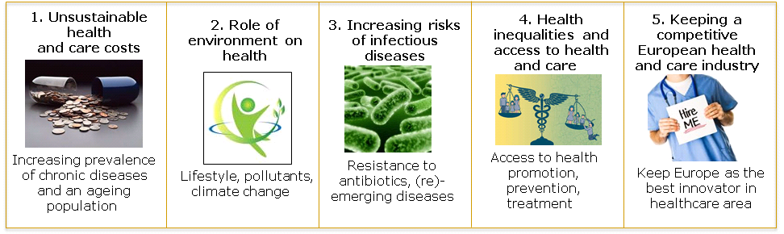
What challenges lie ahead ?
Health care expenditure of EU countries is steadily increasing and now accounts for nearly 10% of GDP, as a result of increasing prevalence of chronic diseases due to unhealthy lifestyles and an ageing population.
Avoidable environmental factors cause 1.4 million deaths yearly in the EU.
Infections resistant to antimicrobials (AMR) cause 25’000 deaths yearly in the EU and 700 000 deaths globally.
Life expectancy in some EU countries is six years lower than the average.
EU healthcare industry accounts for 3% of GDP and 1.5 million employees.

Slide 5
How to design a Research and Innovation programme that will have the impact we want on these challenges?

Slide 6
What do EU R&I offer? What is our basis?
A diversified palette of instruments for R&I -1-
More than 1,000 transnational collaborative projects underway, with over 10,000 participants.
→ Increased European human capital on health research and its excellence. Networking of health R&I across Europe and beyond.
A public-private partnership (the world's largest in health): IMI
→ European-wide unmet medical needs addressed; building on the complementary strengths of industry and academia.
Coordinating national funding programmes : EDCTP, JPND, JPAMR, HBM4EU
→ EU helps countries pooling their resources.

Slide 7
What do EU R&I offer? What is our basis?
A diversified palette of instruments for R&I- 2
Some 10 global consortia of health research funding agencies aligning health R&I funding on an international scale
→ Alignment of international health R&I efforts
A specific finance facility for loans to innovators addressing infectious diseases – InnoFin Infectious Diseases
→ R&I investments leveraged, iincentives to address crucial risky areas, follow-up funding from FP7
Horizon Prizes
→ Innovative solutions to targeted health challenges

Slide 8
Some significant achievements already
A projected 56,000 high-level scientific articles on health
500,000 new compound candidates for new drugs made available to other researchers; and experts across Europe (IMI)
A rapid response to help to eradicate Ebola

Slide 9



EU research investment leveraging other funds
changing breast cancer practice
FP6, 2002-2006
Horizon 2020, 2014-2020
€ 7 million
Validation of
the 70-gene signature
€ 4 million
2015: MammaPrint
final clinical utility
2002: 70-gene signature published
2007: FDA approves Mammaprint
2007
2011
MINDACT trial : Microarray In Node negative Disease may Avoid ChemoTherapy
Leveraged funds:
€ 43 million
Mammaprint reduced
chemotherapy prescription post-surgery by 46%
Phase III CT 6693 women enrolled

Slide 10
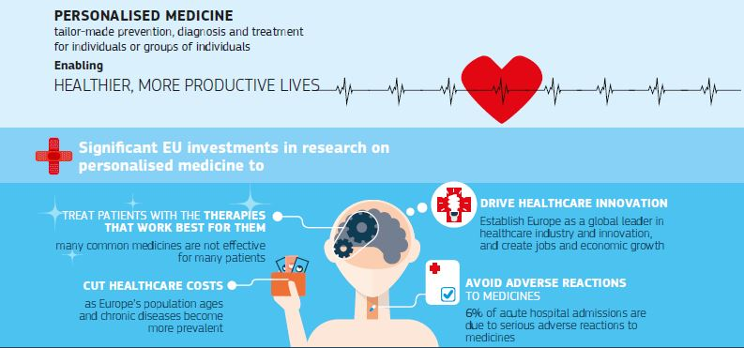

Slide 11
An example of a success story
The project ESPOIR (FP7) developed a new heart valve replacement methodology for children that does not have to activate the immune system and regenerates tissues. It is already accepted and reimbursed in 6 countries.

Slide 12



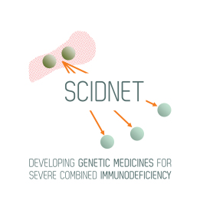

Examples of orphan therapy development funded through Horizon 2020
BATCure : New therapies for a group of rare lysosomal diseases, neuronal ceroid lipofuscinoses or Batten disease
MYOCURE : Innovative gene therapy platform to cure rare hereditary muscle disorders focusing on myotubular myopathy (MTM) and glycogen storage disorder (GSD) type II
UM Cure 2020 : Novel therapeutic approaches for treatment of uveal melanoma
SCIDNET : Developing genetic medicines for Severe Combined Immunodeficiency (SCID)
VISION-DMD : Advancing development of steroid-like orphan drug VBP15 as therapy for patients with Duchenne Muscular Dystrophy
More information available on Cordis Project Search: http://cordis.europa.eu/projects/home_en.html

Slide 13
How can we have more impact ?
Key findings of the Interim Evaluation of Horizon 2020:
An attractive, simplified and well-performing programme, highly relevant for stakeholders and societal needs.
On track to deliver value for money and to meet its knowledge-creation objectives.
Strong EU Added Value through unique opportunities, competition & access to new knowledge.
There is room for improvement:
  The strategic challenges and objectives are not always clearly translated in specific calls and topics.
  Low involvement of civil society (but improved over FP7). Need to bring R&I closer to the public.
  Establish an impact-focused, mission-oriented approach.

Slide 14

“Lamy report” - Recommendation 5: Adopt a mission-oriented, impact-focused approach to address global challenges.
Action: Set research and innovation missions that address global challenges and mobilise researchers, innovators and other stakeholders to realise them.

Slide 15

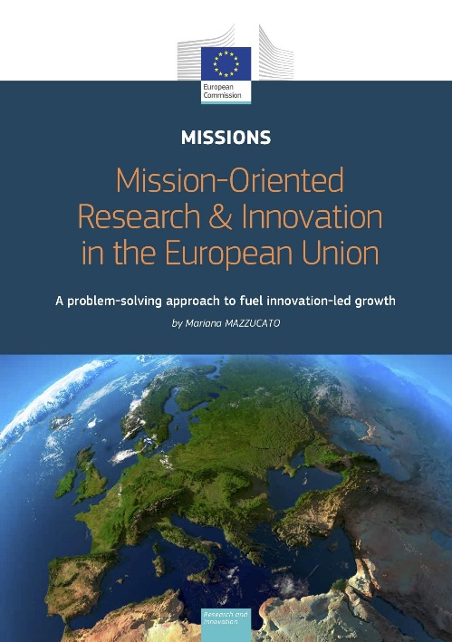
Towards FP9
"We need to define missions that break down silos.
We have made progress in Horizon 2020 to focus resources in selected areas. But we still support too many different projects that disperse or fragment our funding.
We need to set our eyes on a specific target, and drive our scientific efforts towards reaching that target. And we need to be ambitious about it."
The Mazzucato report describes key criteria to select missions and important factors for implementation (released by Prof. Mariana Mazzucato on 22/2/2018).
A Call for feedback on missions on the basis of this report is open until 3 April 2018.

Slide 16

Criteria for selecting R&I missions
proposed by Prof Mazzucato
Bold, inspirational, with wide societal relevance
A clear direction: targeted, measurable and time-bound
Ambitious but realistic R&I actions
Cross-disciplinary, cross-sectoral and cross-actor innovation
Multiple bottom-up solutions

Slide 17
Key factors for implementing
R&I missions at EU level
  Engagement of diverse national and regional stakeholders
  Measurement of progress and impact by goals and milestones
  A portfolio of instruments to foster bottom-up solutions
  Flexibility, pro-active management and building in-house capabilities
  Public engagement
    Public participation in the selection process
    Public inclusion in the implementation/citizens as active participants in missions

Slide 18
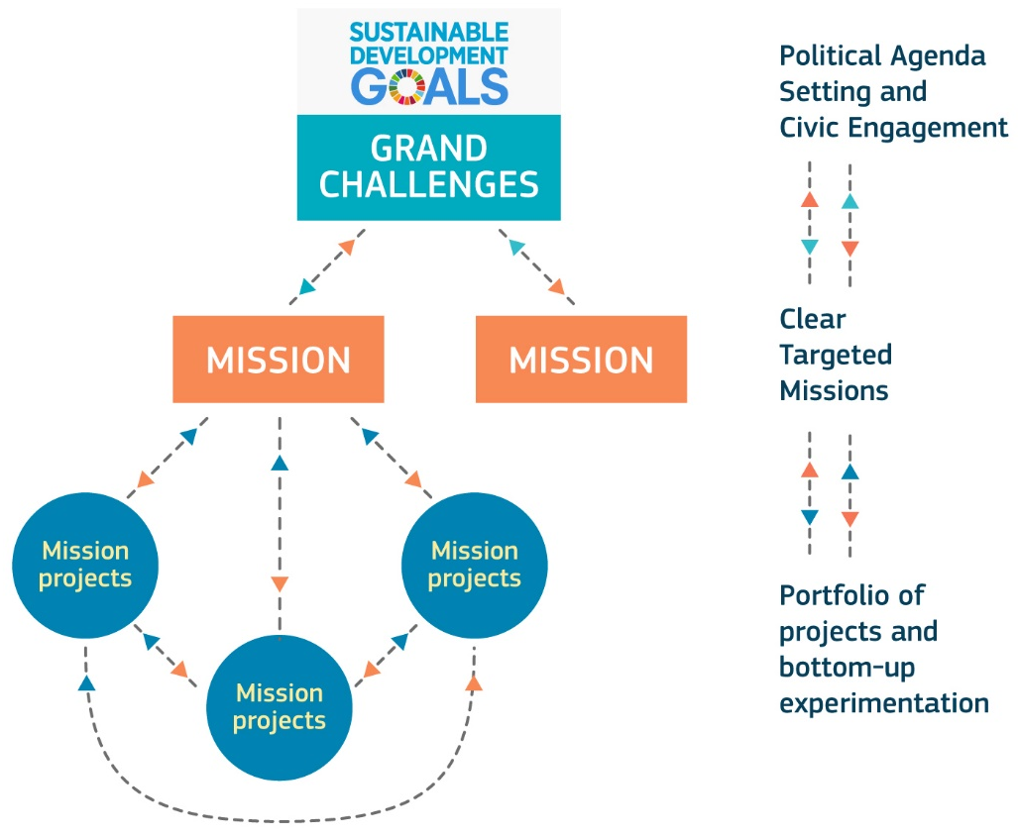
Moving from broad challenges to specific missions
“The 'granularity' of European research and innovation missions sits between broad challenges and concrete projects. Missions set clear and ambitious objectives that can only be achieved by a portfolio of research and innovation projects and supportive measures.” (Mazzucato report)

Slide 19


Illustrative example from Horizon 2020: tackling the global challenge of rare diseases
Challenges
6,000-8,000 diseases - more than 30 million patients in EU
Huge unmet medical needs for patients across the globe
Small patient populations for individual diseases
Scarce and scattered research resources and expertise
© yurii bezrukov /Fotolia.com
established in 2011
Over 50 international partners from 5 continents: public funders, private companies, foundations and patient organisations

Slide 20

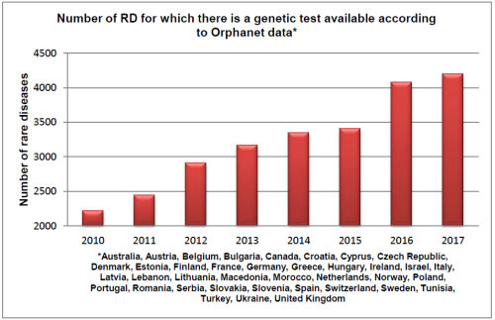
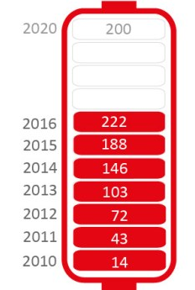

“to stimulate, coordinate & maximise output of rare disease research efforts around the world"
Goals by 2020:
200 new therapies for rare diseases
Means to diagnose most rare diseases
www.IRDiRC.org
Goal achieved in 2016
Number of new orphan drugs, EMA and FDA cumulatively
Number of genetic tests available

Slide 21
THANK YOU
FOR YOUR ATTENTION

Slide 22

Find out more:
http://ec.europa.eu/programmes/horizon2020/
http://ec.europa.eu/research/health/index.cfm?pg=home
Funding opportunities:
http://ec.europa.eu/research/participants/portal/desktop/en/home.html
Information about financial instruments:
http://www.eib.org/products/blending/innovfin/

