Slide 1
Maximizing the value and the impact of health research in Europe
April 25, 2018, Brussels
Karin Sipido, MD PhD
Chair, H2020 Scientific Panel for Health

Slide 2
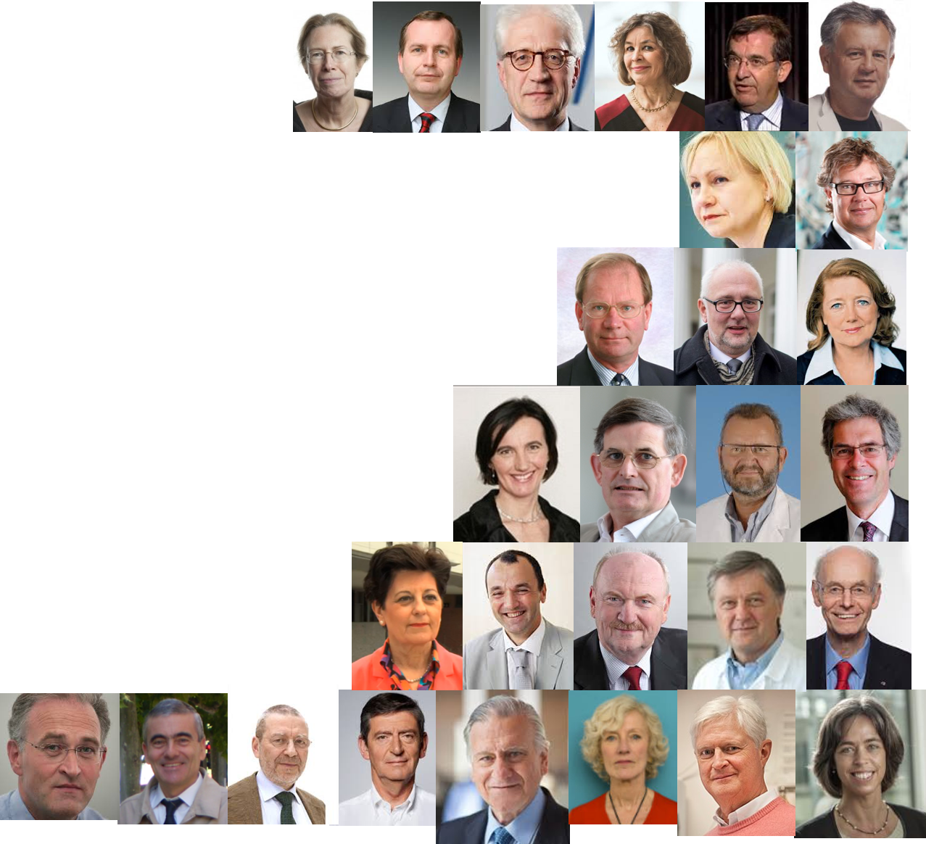

The Scientific Panel for Health
  27 experts across disciplines and activities
  advisors and liaisons to the community
Our mandate
to provide foresight, overall vision, strategy
to identify bottlenecks to innovation and propose solutions
  recommendations
Notes:
Updated and improved images

Slide 3

Engaging with stakeholders through workshops, survey, conferences
Civic society
Research
organizations
Funders
SPH
Academia
Charities
Healthcare organizations
Industry
Government/
policymakers

Slide 4

















2017 Scientific Panel for Health Conference
Health research in a connected and
participative society
environment
population
interventions
societal participation
& benefit
research & discovery
innovation
public health
systems medicine
big data
novel technologies
multi-stakeholder collaboration
market
mechanisms
devices
health & economic value

Slide 5
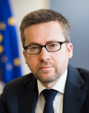
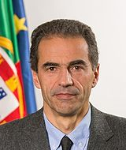
“There are many competing political priorities, so we must all shout about the importance of health research and innovation systems.”
Carlos Moedas, EU Commissioner
Research, Science & Innovation
“Specific needs for health research need further investment and require a collective effort in the years to come.”
Manuel Heitor, Minister of Science, Technology & Education, Portugal

Slide 6
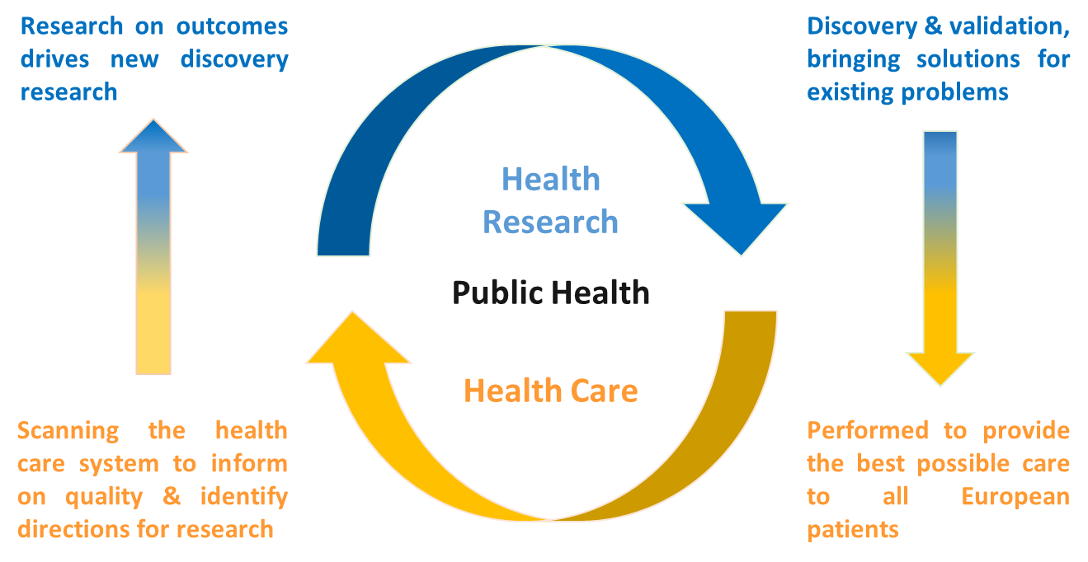
Specific needs and opportunities for health research
Health, health care and health research form a unique and interdependent ecosystem

Slide 7
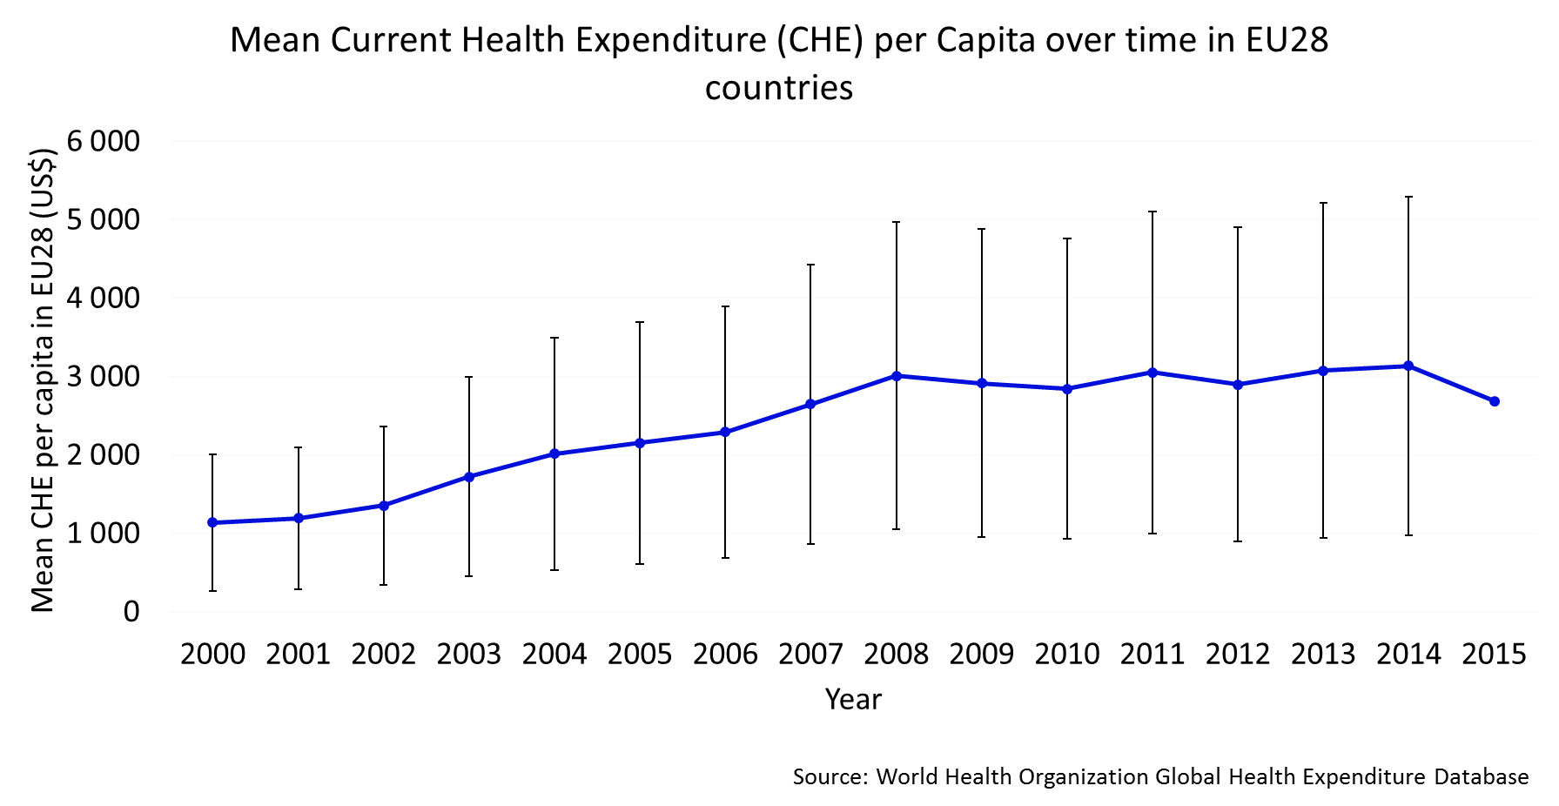
The rising costs in health care can only be managed through research underpinning decisions for implementation
Health care is a national competence but cannot be separated from research. Health research at the EU-level can identify and address mechanisms that reduce health inequality

Slide 8
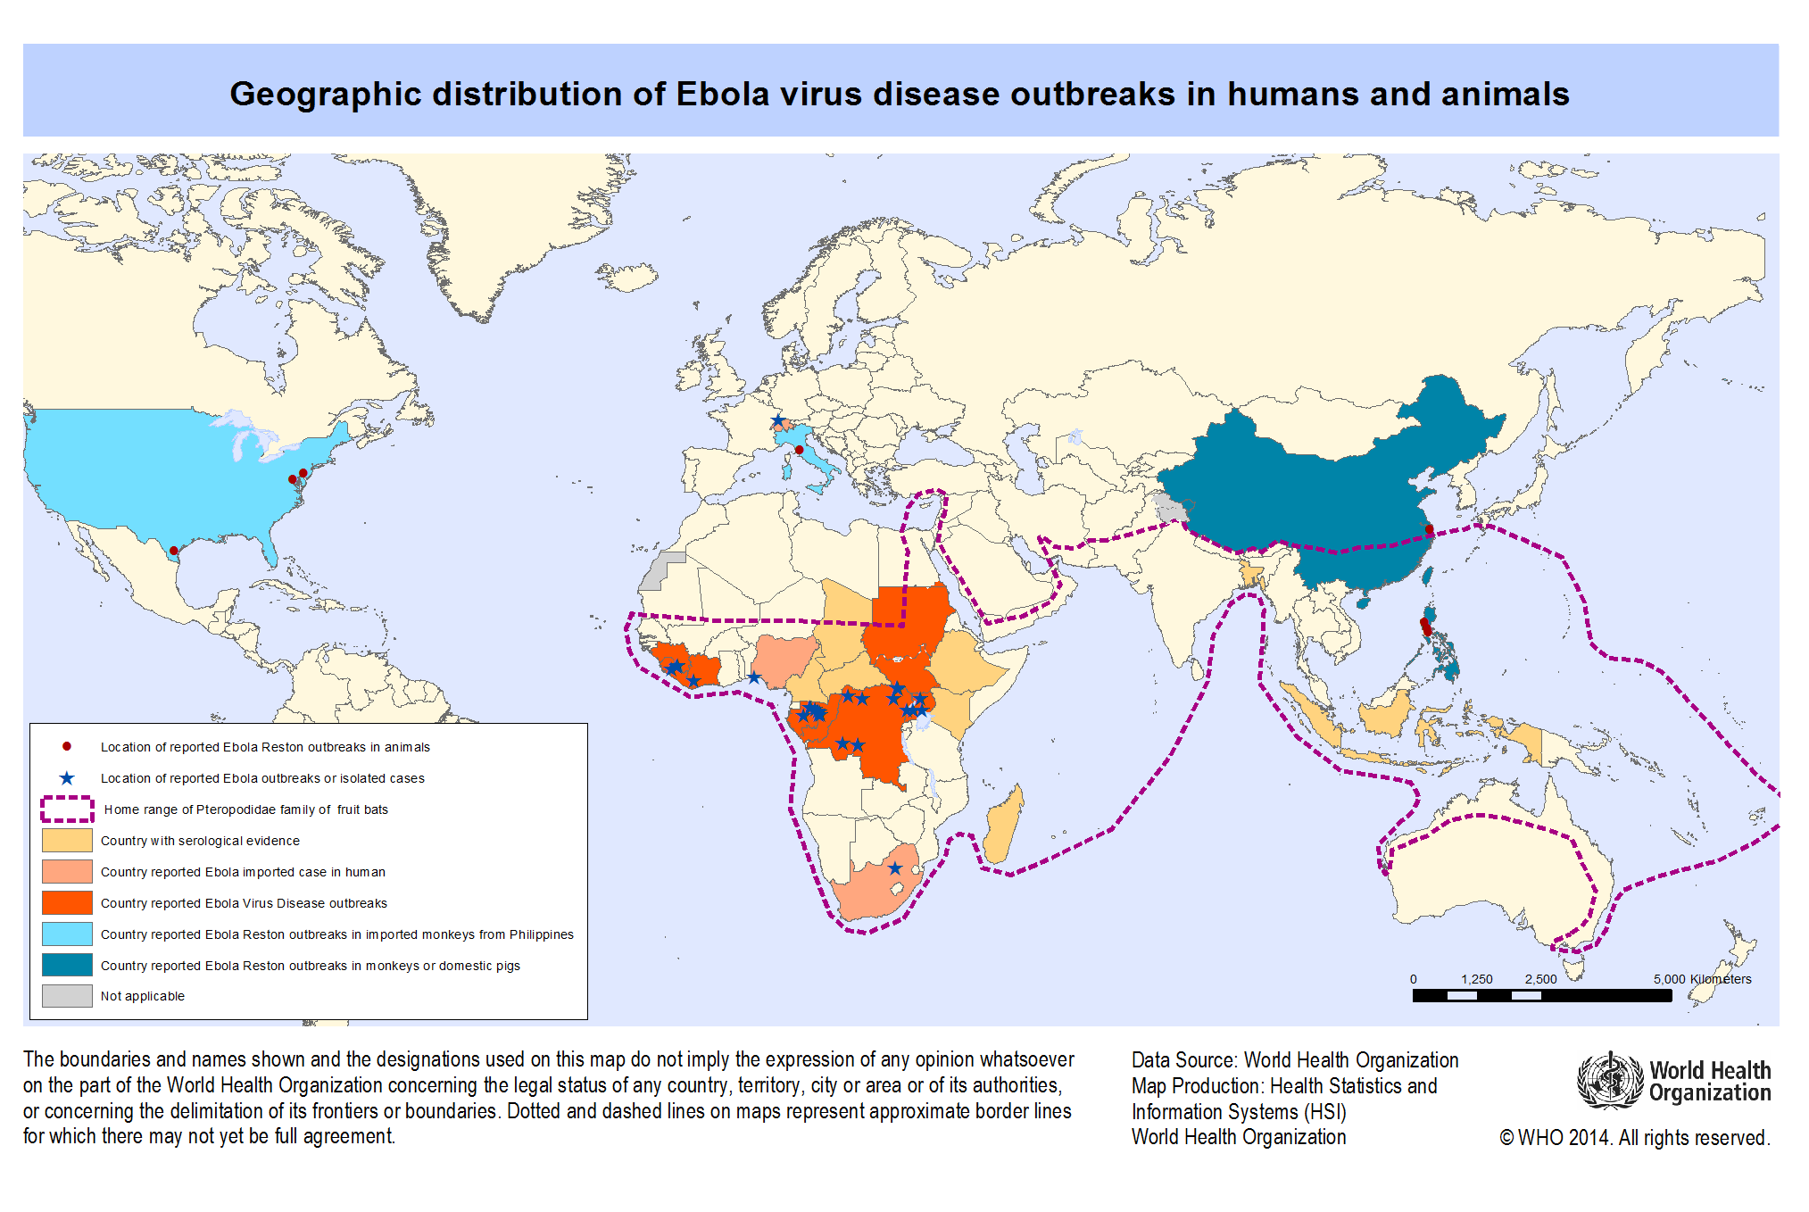
Health has no borders - we need ‘health in all policies’ – no silos

Slide 9
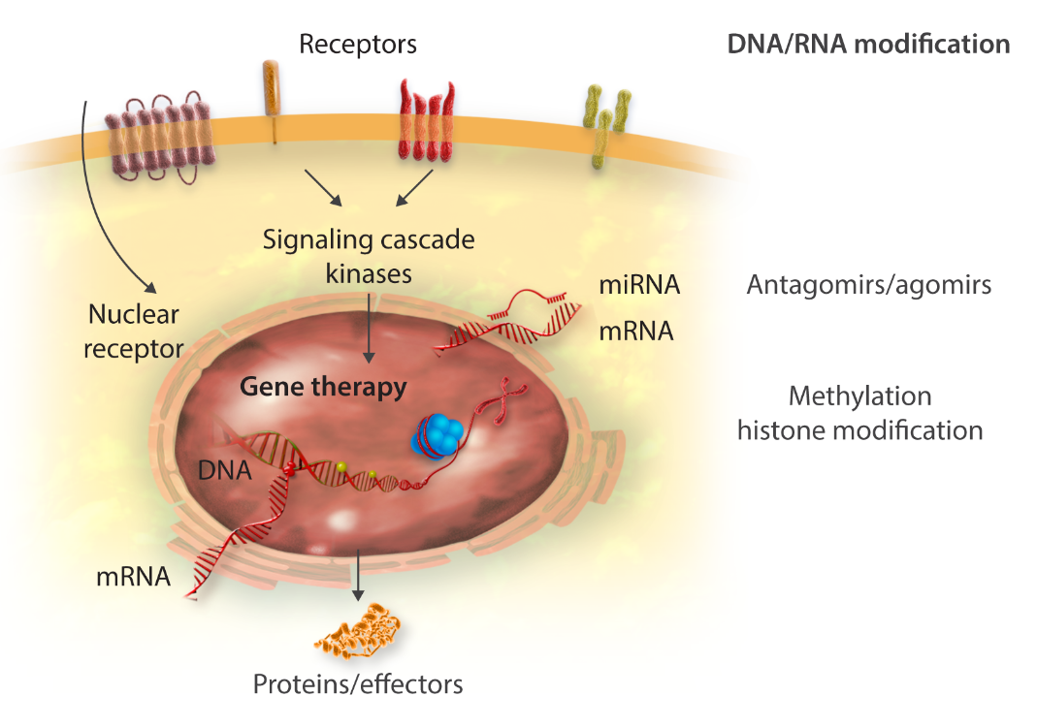
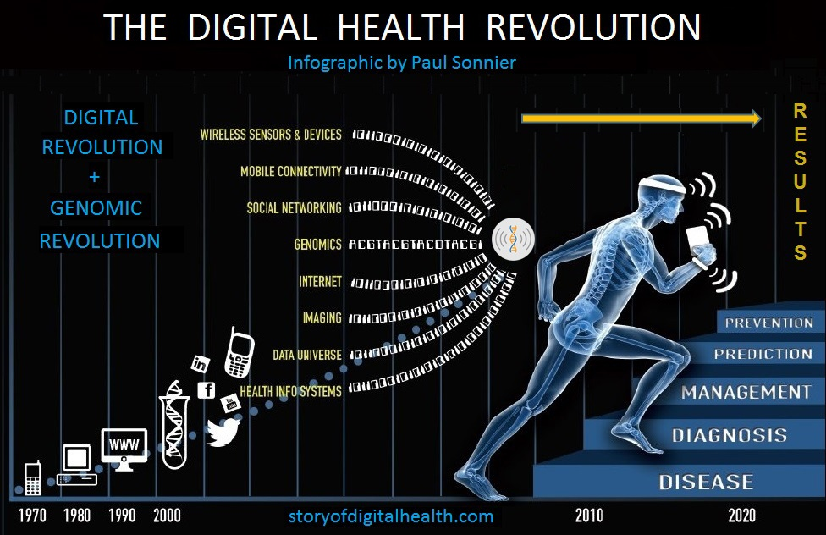
Opportunities from scientific and technological innovation

Slide 10
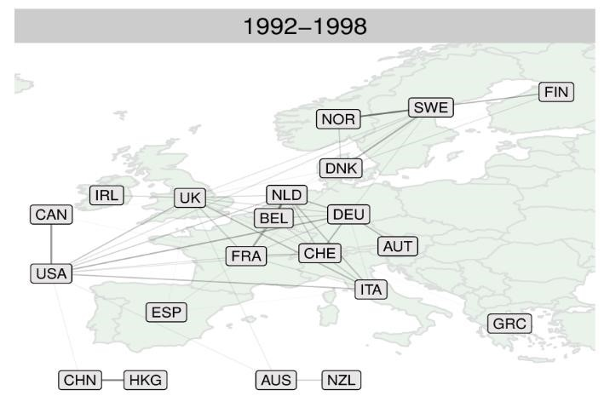
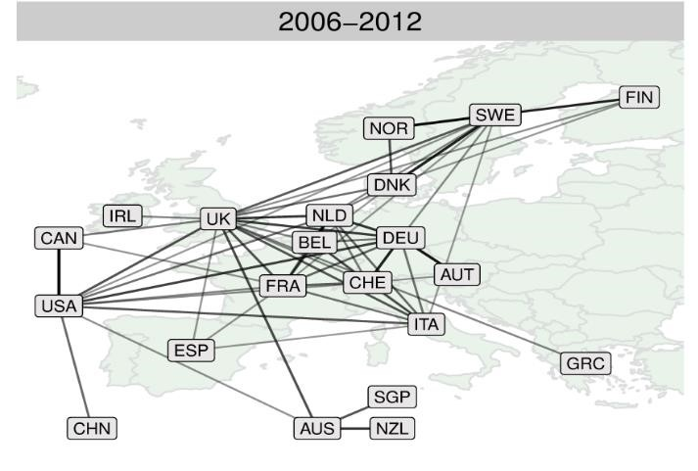
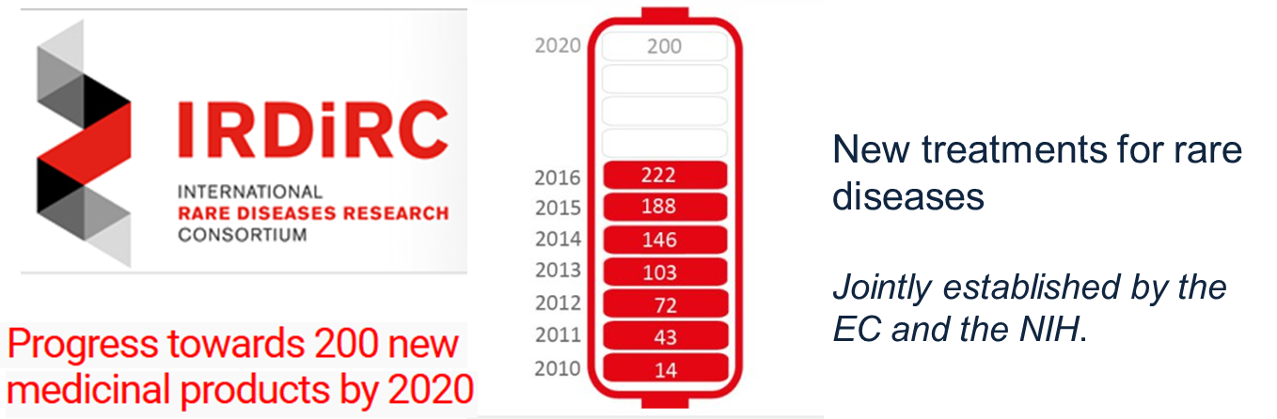
Building on the achievements of the EU programs in health research
EU as leader in collaborative research
High-impact collaborative
studies in cardiovascular
disease
Eur Heart J 2017

Slide 11
EU as prime funder of collaborative research
Public funding
R&D - all
*Public funding
multinational collaborative research
*Scientific Panel for Health- estimate based on MS funding schemes and EC reporting

Slide 12
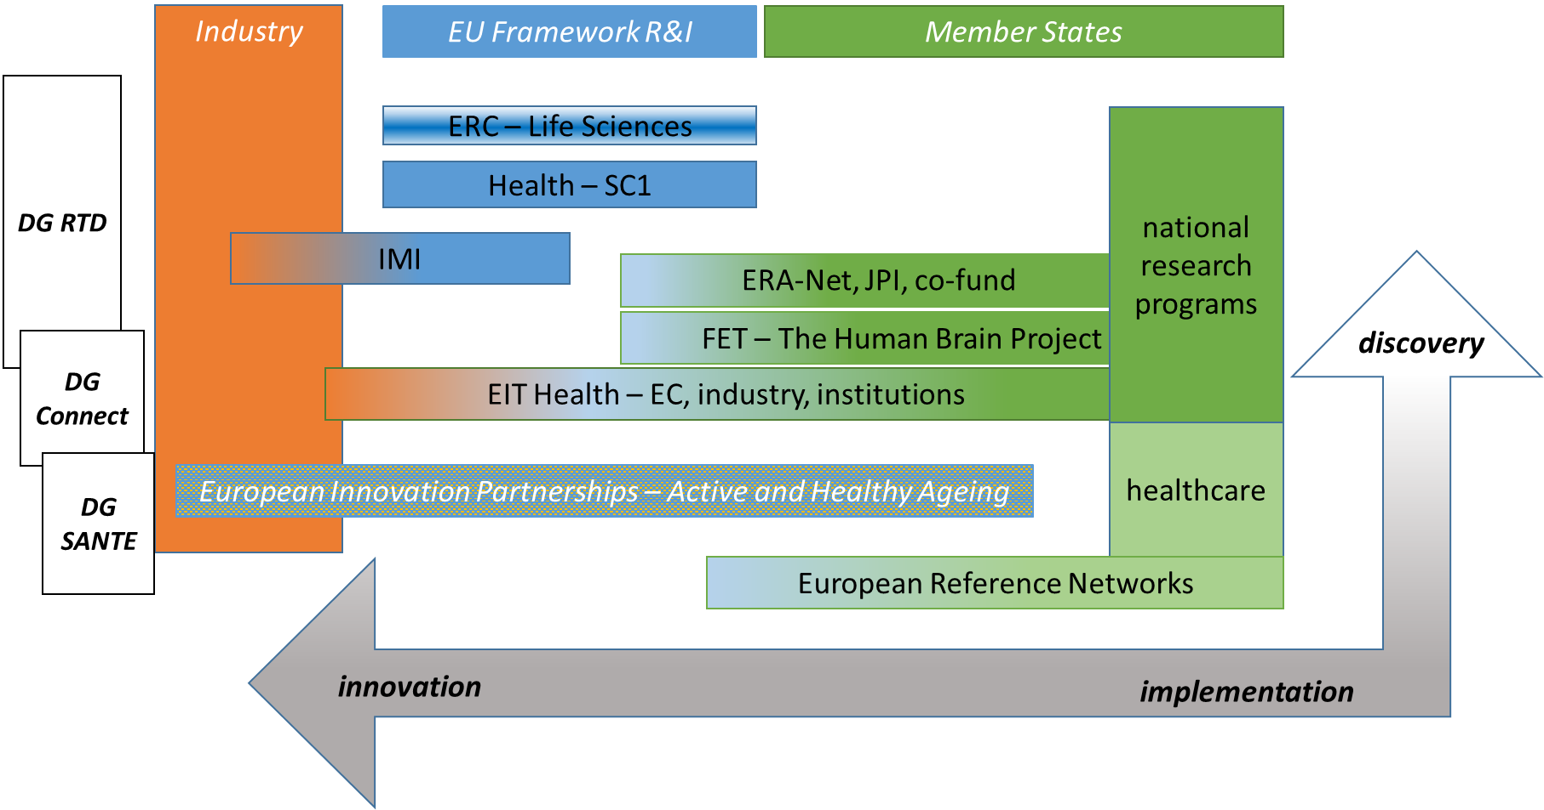
A rich but complex landscape of health research funding in Europe

Slide 13
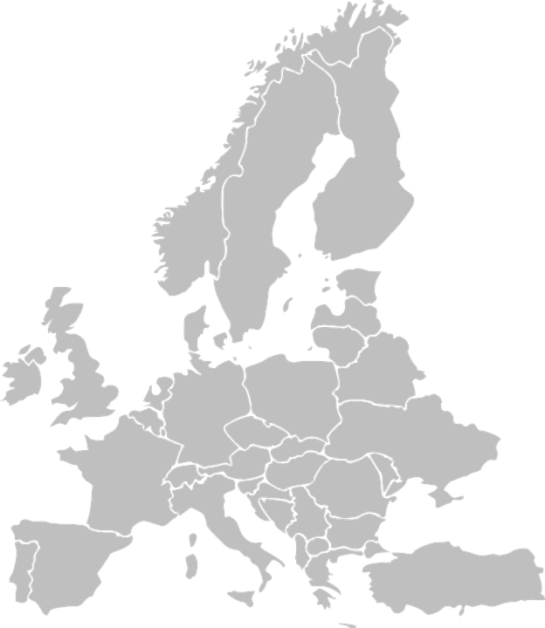
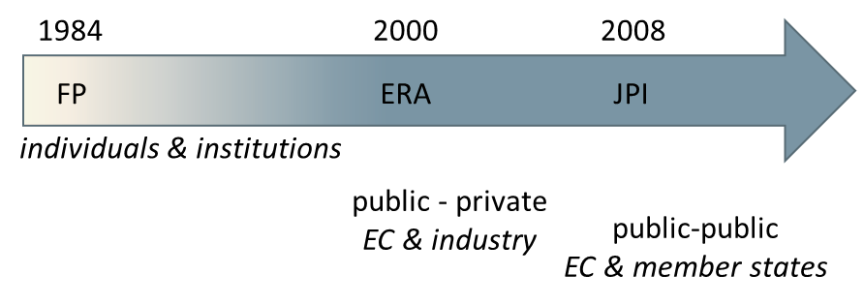
To increase impact, European health research would benefit from
EU-wide vision and strategy for health research across sectors and borders
Synergy with more cohesive and better aligned funding, programs and initiatives
Continuity in a long-term vision to increase efficiency and facilitate sustainable results
Visibility & leadership
More equality between European countries
Comprehensive policy
Synergy of programs

Slide 14
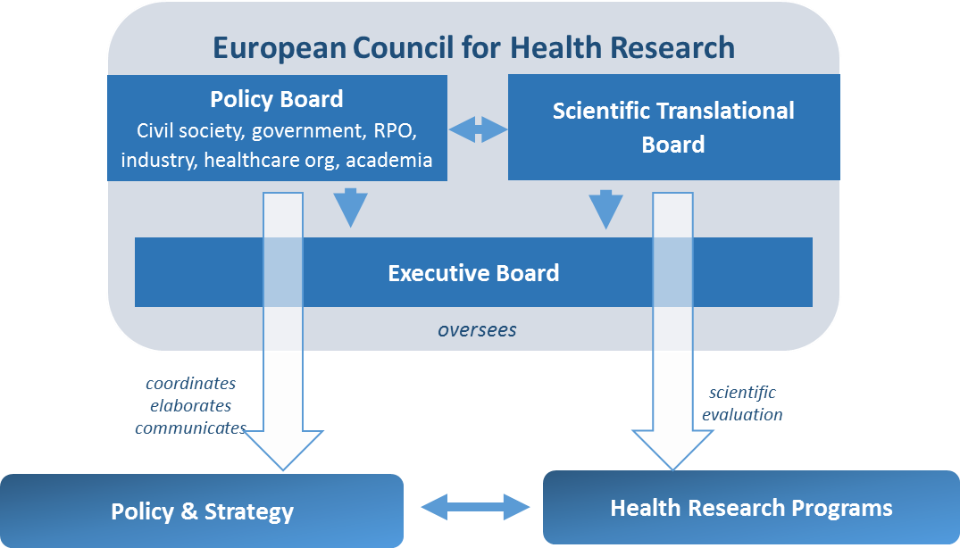
A next step for implementation
‘..to increase the impact of health research to achieve better health and well-being of citizens creating societal and economic value’

Slide 15
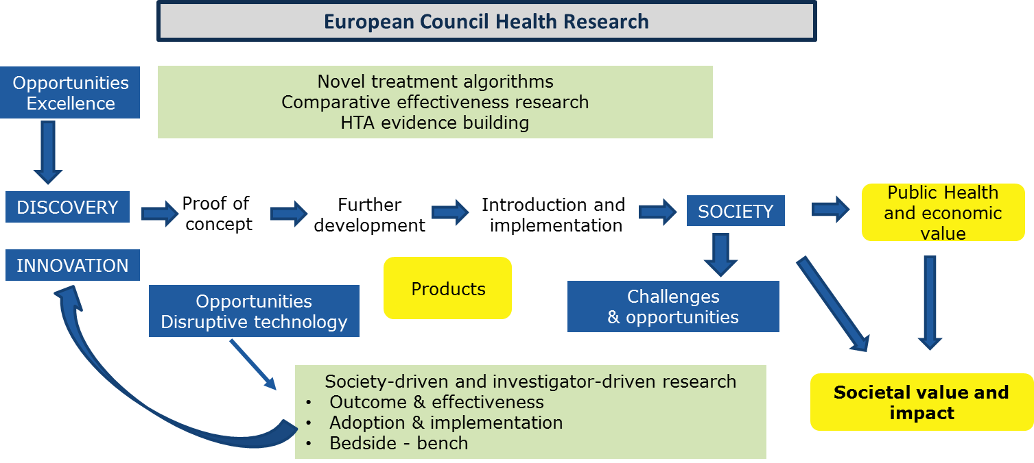

Slide 16


It is time
to respond to citizens’ concern
  2017 Eurobarometer: 70% of EU citizens demanded for more EU action in the field of health
  global commitment to health (Sustainable Development Goals)
to implement high-level recommendations for impactful, mission-driven research that puts citizens at the center
to build on member state initiatives
to create visible, strong leadership in health research
for a political dialogue to secure the future of health research

